Slide 1

CSE 3521: Introduction to Artificial Intelligence
[Many slides are adapted from the UC Berkeley. CS188 Intro to AI at UC Berkeley and previous CSE 3521 course at OSU.]

Slide 2

Logical Inference
Knowledge-based logical agents
Knowledge base and representation
Entailment and inference
Propositional logic

Slide 3
In which we design agents that can form representations of the world, use a process of inference to derive new representations about the world, and use these new representations to deduce what to do.
In contrast, planning agents find the best action sequence by strategically trial and error in the simulation!

Slide 4

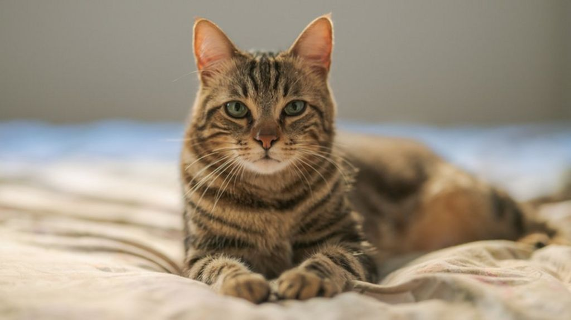
Knowledge-Based Logical Agents
Two central concepts
Representation of knowledge (state sequences?)
Reasoning processes acting on knowledge (e.g., choose actions)
Play crucial role in “Partially Observable” environments
Combine general knowledge with current percepts to infer hidden aspects before acting
Aids in agent flexibility
Learn new knowledge for new tasks
Adapt to changes in environment by updating relevant knowledge

Slide 5
Knowledge Base
Central component is its knowledge base (KB)
Contains set of “sentences” (in knowledge representation language)
KB initially contains some background knowledge
How to add new information to KB?
TELL function
Inference: deriving new sentences from old ones
How to query what is known?
ASK function
Answers should follow what has been told to the KB previously
Tell Ask
KB

Slide 6
Logic
For logical agents, knowledge is definite
Each proposition is either “True” or “False”
Logic has advantage of being simple representation for knowledge-based agents
But limited in its ability to handle uncertainty
We will examine propositional logic and first-order logic

Slide 7
Wumpus World Environment
Simple environment to motivate logical reasoning
Agent explores cave with rooms connected by passageways
“Wumpus” beast lurking somewhere in cave
Eats anyone who enters its room
Agent has one arrow (can kill Wumpus)
Some rooms contain bottomless pits
Occasional heap of gold present
Agent task
Enter cave, find the gold, return to entrance, and exit
Stench
breeze
PIT
breeze
PIT
breeze
Stench
gold
Stench
breeze
PIT
breeze
breeze
Start

Slide 8
Wumpus World PEAS Description
(P)erformance measure
Cost of –1000 for falling into pit or being eaten by Wumpus (GAME OVER!)
Receive +1000 for picking up gold
Cost of –1 for each action taken
Cost of –10 for using up the only arrow
(E)nvironment
4x4 grid of rooms
Agent starts in square [1,1]
Wumpus and gold locations chosen randomly
Probability of square being a pit is .2
[0=no, …, 0.5=maybe, …, 1=yes]
Stench
breeze
PIT
breeze
PIT
breeze
Stench
gold
Stench
breeze
PIT
breeze
breeze
Start

Slide 9
Wumpus World PEAS Description
(A)ctuators
Move forward, turn left, turn right
Note: die if enter pit or live wumpus square
Grab (gold)
Shoot (arrow)
Kills wumpus if facing its square
(S)ensors
Nose: squares adjacent to wumpus are “smelly”
Skin/hair: Squares adjacent to pit are “breezy”
Eye: “Glittery” if and only if gold is in the same square
Percepts: [Stench, Breeze, Glitter]
Stench
breeze
PIT
breeze
PIT
breeze
Stench
gold
Stench
breeze
PIT
breeze
breeze
Start

Slide 10
Exploring a Wumpus World
A = agent
B = breeze
G = glitter, gold
OK = safe square
P = pit
S = stench
V = visited
W = Wumpus
OK
OK
OK
A
From local percepts, determines that {(1,1), (1,2), (2,1)} are free from danger.

Slide 11
Exploring a Wumpus World
A = agent
B = breeze
G = glitter, gold
OK = safe square
P = pit
S = stench
V = visited
W = Wumpus
OK
P?
OK
OK
B
V
A
P?
From breeze percept, determines that (2,2) or (3,1) is a pit. Go back to (1,1) and move up to (1,2).

Slide 12
Exploring a Wumpus World
A = agent
B = breeze
G = glitter, gold
OK = safe square
P = pit
S = stench
V = visited
W = Wumpus
W
OK
S
OK
A
P?
OK
OK
B
V
V
PIT
P?
From stench and no-breeze percept in (1,2), determines that Wumpus in (1,3), pit in (3,1), and (2,2) clear.

Slide 13
Exploring a Wumpus World
A = agent
B = breeze
G = glitter, gold
OK = safe square
P = pit
S = stench
V = visited
W = Wumpus
W
OK
W!
OK
S
OK
OK
V
A
OK
OK
B
V
V
PIT
P?
From local percepts, it is OK to move up or right.

Slide 14
Exploring a Wumpus World
A = agent
B = breeze
G = glitter, gold
OK = safe square
P = pit
S = stench
V = visited
W = Wumpus
P?
W
S
G
B
W!
A
P?
gold
OK
S
OK
OK
V
V
OK
OK
B
V
V
PIT
P?
Found gold! No need to explore further. Time to head back.

Slide 15
Exploring a Wumpus World
A = agent
B = breeze
G = glitter, gold
OK = safe square
P = pit
S = stench
V = visited
W = Wumpus
P?
S
G
B
W!
A
P?
gold
OK
S
OK
OK
V
V
OK
OK
B
V
V
PIT
P?
Then go home using OK squares (retrace route).

Slide 16
Tight Spot
P?
OK
B
A
P?
OK
OK
B
A
A
P?
Breeze in (1,2) and (2,1) → no safe actions!
Pit may actually only be in (2,2), but can’t tell.

Slide 17
More Tight Spot
S
A
Smell in (1,1) → Cannot move!
Possible action: shoot arrow straight ahead

Slide 18
Logical Agent
Need agent to represent beliefs
“There is a pit in (2, 2) or (3, 1)”
“There is no Wumpus in (2, 2)”
Need to make inferences
If available information is correct, draw a conclusion that is guaranteed to be correct
Need representation and reasoning
Support the operation of knowledge-based agent

Slide 19
Knowledge Representation
For expressing knowledge in computer-tractable form
Knowledge representation language defined by
Syntax
Defines the possible well-formed configurations of sentences in the language
Semantics
Defines the “meaning” of sentences (need interpreter)
Defines the truth of a sentence in a world (or model)

Slide 20
The Language of Arithmetic
Syntax: “x + 2 ≥ y” is a sentence
“x2 + y >” is not a sentence
Semantics: x + 2 ≥ y is true iff the number x + 2 is no less than the number y
x + 2 ≥ y is True in a world where x=7, y=1
x + 2 ≥ y is False in a world where x=0, y=6

Slide 21
Inference
Sentence is valid iff it is true under all possible interpretations in all possible worlds
Also called tautologies
“There is a stench at (1,1) or there is not a stench at (1,1)”
“There is an open area in front of me” is not valid in all worlds
Sentence is satisfiable iff there is some interpretation in some world for which it is true
“There is a wumpus at (1,2)” could be true in some situation
“There is a wall in front of me and there is no wall in front of me” is unsatisfiable

Slide 22
Propositional Logic: Syntax
Syntax of propositional logic defines allowable sentences
Atomic sentences consists of a single proposition symbol
Each symbol stands for proposition that can be True or False
Symbols of propositional logic
Propositional symbols: P, Q, … (e.g., “Today is Tuesday”)
Logical constants: True, False
Making complex sentences
Logical connectives of symbols: ∧, ∨, ⇔, ⇒, ¬
Also have parentheses to enclose each sentence: (…)
Sentences will be used for inference/problem-solving

Slide 23
Propositional Logic: Syntax
True, False, S₁, S₂, … are sentences
If S is a sentence, ¬S is a sentence
Not (negation)
S₁ ∧ S₂ is a sentence, also (S₁ ∧ S₂)
And (conjunction)
S₁ ∨ S₂ is a sentence
Or (disjunction)
S₁ ⇒ S₂ is a sentence (e.g., “Today is Tuesday” implies “Tomorrow is Wednesday”)
Implies (conditional)
S₁ ⇔ S₂ is a sentence
Equivalence (biconditional)

Slide 24
Propositional Logic: Semantics
Semantics defines the rules for determining the truth of a sentence
With respect to a particular model)
¬S is true iff S is false
S₁ ∧ S₂ is true iff S₁ is true and S₂ is true
S₁ ∨ S₂ is true iff S₁ is true or S₂ is true
S₁ ⇒ S₂ is true iff S₁ is false or S₂ is true
(is false iff S₁ is true and S₂ is false)
(if S₁ is true, then claiming that S₂ is true, otherwise make no claim)
S₁ ⇔ S₂ is true iff S₁ ⇒ S₂ is true and S₂ ⇒ S₁ is true (S₁ same as S₂)

Slide 25
Semantics in Truth Table Form
P | Q | ¬P | P ∧ Q | P ∨ Q | P ⇒ Q | P ⇔ Q
False | False
False | True
True | False
True | True
True
False
False
True
True
True
False
True
True
False
False
False
True
False
False
False
True
True
True
True

Slide 26
Propositional Inference: Enumeration Method
Truth tables can test for valid sentences
True under all possible interpretations in all possible worlds
For a given sentence, make a truth table
Columns as the combinations of propositions in the sentence
Rows with all possible truth values for proposition symbols
If sentence true in every row, then valid

Slide 27
Propositional Inference: Enumeration Method
Test ((P ∨ H) ∧ ¬ H ) ⇒ P
P | H | P ∨ H | ¬H | (P ∨ H) ∧ ¬H | ((P ∨ H) ∧ ¬H ) ⇒ P
False | False
False | True
True | False
True | True
False
True
False
True
True
False
False
True
True
True
True
True
True
False
False
True

Slide 28
Practice
Test (P ∧ H) ⇒ (P ∨ ¬ H)

Slide 29
Practice
Test (P ∧ H) ⇒ (P ∨ ¬ H)
P | H | P ∧ H | ¬H | (P ∨ ¬H) | (P ∧ H) ⇒ (P ∨ ¬ H)
False | False
False | True
True | False
True | True
False
True
True
True
False
False
False
True
False
True
True
True
True
False
True
True

Slide 30
Simple Wumpus Knowledge Base
For simplicity, only deal with the pits
Choose vocabulary
Let P_{i,j} be True if there is a pit in [i,j]
Let B_{i,j} be True if there is a breeze in [i,j]
KB sentences
FACT: “There is no pit in [1,1]”
R₁: ¬ P_{1,1}
RULE: “There is breeze in adjacent neighbor of pit”
R₂: B_{1,1} ⇔ (P_{1,2} ∨ P_{2,1} )
R₃: B_{2,1} ⇔ (P_{1,1} ∨ P_{2,2} ∨ P_{3,1} )
Need rule for each square!

Slide 31
Wumpus Environment
Given knowledge base
Include percepts as move through environment (online)
Need to “deduce what to do”
Derive chains of conclusions that lead to the desired goal
Use inference rules
Inference rule: “α derives β”
Knowing α is true, then β must also be true

Slide 32
Inference Rules for Prop. Logic
Modus Ponens
From implication and premise of implication, can infer conclusion

Slide 33
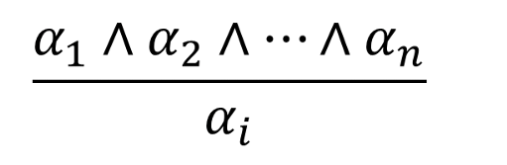
Inference Rules for Prop. Logic
And-Elimination
From conjunction, can infer any of the conjuncts

Slide 34
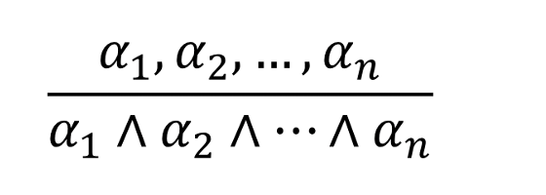
Inference Rules for Prop. Logic
And-Introduction
From list of sentences, can infer their conjunction

Slide 35
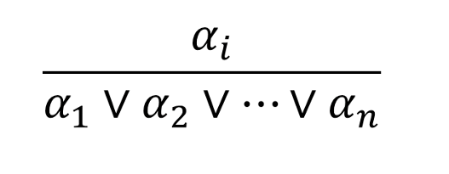
Inference Rules for Prop. Logic
Or-Introduction
From sentence, can infer its disjunction with anything else

Slide 36

Inference Rules for Prop. Logic
Double-Negation Elimination
From doubly negated sentence, can infer a positive sentence
$$\frac{¬¬α}{α}$$

Slide 37
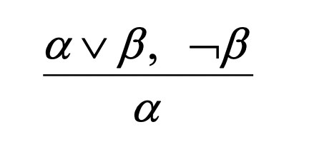
Inference Rules for Prop. Logic
Unit Resolution
From disjunction, if one of the disjuncts is false, can infer the other is true

Slide 38


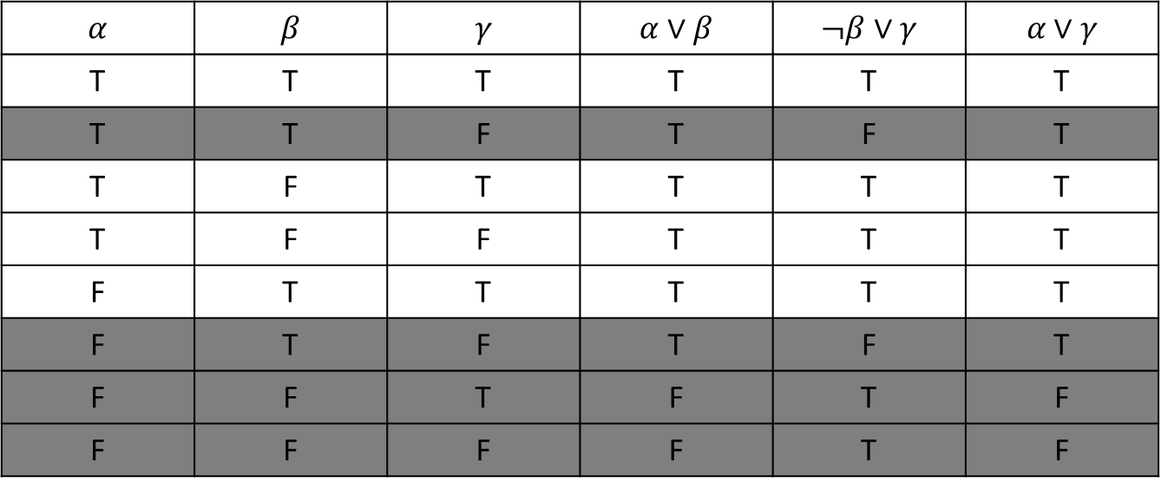
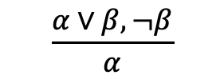



Inference Rules for Prop. Logic
Resolution
Most difficult because β cannot be both true and false
One of the other disjuncts must be true in one of the premises
(implication is transitive)
$$α$$ | $$β$$ | $$γ$$ | $$α∨β$$ | $$¬β∨γ$$ | $$α∨γ$$
T | T | T | T | T | T
T | T | F | T | F | T
T | F | T | T | T | T
T | F | F | T | T | T
F | T | T | T | T | T
F | T | F | T | F | T
F | F | T | F | T | F
F | F | F | F | T | F
$$¬β$$
OR
$$β$$
$$\frac{α∨β, ¬β}{α}$$
OR
$$\frac{¬β∨γ, β}{γ}$$
$$α$$
OR
$$γ$$

Slide 39
TASK: Find the Wumpus
Can we infer that the Wumpus is in cell (1,3), given our percepts and environment rules?
A = agent
B = breeze
OK = safe square
S = stench
V = visited
W = wumpus
4
W!
3
OK
S
OK
2
A
OK
OK
B
1
V
V
PIT
1 2 3 4

Slide 40
Wumpus Knowledge Base
Percept sentences (facts) “at this point”
¬ S_{1,1} ¬ B_{1,1}
¬ S_{2,1} B_{2,1}
S_{1,2} ¬ B_{1,2}
OK
S
2
A
OK
OK
B
1
V
V
1 2

Slide 41
Environment Rules
R₁: ¬ S_{1,1} ⇒ ¬ W_{1,1} ∧ ¬ W_{1,2} ∧ ¬ W_{2,1}
W?
3
OK
S
OK
2
A
OK
OK
1
1 2 3

Slide 42
Environment Rules
R₂: ¬ S_{2,1} ⇒ ¬ W_{1,1} ∧ ¬ W_{2,1} ∧ ¬ W_{2,2} ∧ ¬ W_{3,1}
W?
3
OK
S
OK
2
A
OK
OK
1
1 2 3

Slide 43
Environment Rules
R₃: ¬ S_{1,2} ⇒ ¬ W_{1,1} ∧ ¬ W_{1,2} ∧ ¬ W_{2,2} ∧ ¬ W_{1,3}
W?
3
OK
S
OK
2
A
OK
OK
1
1 2 3

Slide 44
Environment Rules
R₄: S_{1,2} ⇒ W_{1,3} ∨ W_{1,2} ∨ W_{2,2} ∨ W_{1,1}
3
OK
S
OK
2
A
OK
OK
1
1 2 3

Slide 45

Conclude W_{1,3} ?
Does the Wumpus reside in square (1,3) ?
In other words, can we infer W_{1,3} from our knowledge base?

Slide 46
Conclude W_{1,3} (Step #1)
Modus Ponens
R₁: ¬ S_{1,1} ⇒ ¬ W_{1,1} ∧ ¬ W_{1,2} ∧ ¬ W_{2,1}
Percept: ¬ S_{1,1}
Infer
¬ W_{1,1} ∧ ¬ W_{1,2} ∧ ¬ W_{2,1}

Slide 47
Conclude W_{1,3} (Step #2)
α₁˄ α₂˄…˄α_{n}
And-Elimination
¬ W_{1,1} ∧ ¬ W_{1,2} ∧ ¬ W_{2,1}
Infer
¬ W_{1,1} ¬ W_{1,2} ¬ W_{2,1}
α_{i}

Slide 48
Conclude W_{1,3} (Step #3)
Modus Ponens
R₂: ¬ S_{2,1} ⇒ ¬ W_{1,1} ∧ ¬ W_{2,1} ∧ ¬ W_{2,2} ∧ ¬ W_{3,1}
Percept: ¬ S_{2,1}
Infer
¬ W_{1,1} ∧ ¬ W_{2,1} ∧ ¬ W_{2,2} ∧ ¬ W_{3,1}
And-Elimination
¬ W_{1,1} ¬ W_{2,1} ¬ W_{2,2} ¬ W_{3,1}
α₁˄ α₂˄…˄α_{n}
α_{i}

Slide 49
Conclude W_{1,3} (Step #4)
Modus Ponens
R₄: S_{1,2} ⇒ W_{1,3} ∨ W_{1,2} ∨ W_{2,2} ∨ W_{1,1}
Percept: S_{1,2}
Infer
W_{1,3} ∨ W_{1,2} ∨ W_{2,2} ∨ W_{1,1}

Slide 50
Conclude W_{1,3} (Step #5)
Unit Resolution
W_{1,3} ∨ W_{1,2} ∨ W_{2,2} ∨ W_{1,1} from Step #4
¬ W_{1,1} from Step #2
Infer
W_{1,3} ∨ W_{1,2} ∨ W_{2,2}

Slide 51
Conclude W_{1,3} (Step #6)
Unit Resolution
W_{1,3} ∨ W_{1,2} ∨ W_{2,2} from Step #5
¬ W_{2,2} from Step #3
Infer
W_{1,3} ∨ W_{1,2}

Slide 52
Conclude W_{1,3} (Step #7)
Unit Resolution
W_{1,3} ∨ W_{1,2} from Step #6
¬ W_{1,2} from Step #2
Infer
W_{1,3} → The wumpus is in cell 1,3!!!

Slide 53
Wumpus in W_{1,3}
W!
3
OK
S
OK
2
A
OK
OK
1
1 2 3

Slide 54
Propositional Logic
Propositional logic commits to existence of facts about the world being represented
Simple syntax and semantics
Proof methods
Truth table
Inference rules
Modus Ponens
And-Elimination
And/Or-Introduction
Double-Negation Elimination
Unit Resolution
Resolution
Propositional logic quickly becomes impractical

